Slide 1
C-Queues

Slide 2
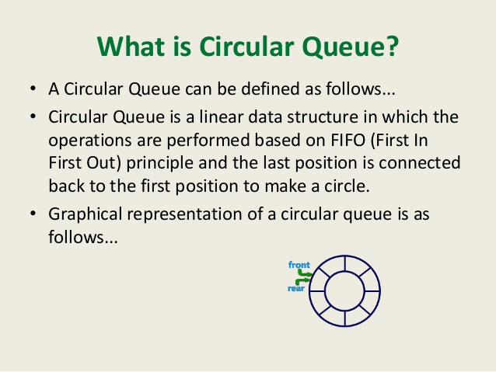


Slide 3
Circular Queues
rear=3
Wrapped around array
3
2
C
front=0
1
n-1
3
2
1
0
B
…
…
C
B
A
0
A
rear=3
front=0
n-1

Slide 4
EnQueue & DeQueue In Circular Array
EnQueue
  rear = (rear + 1) MOD n
DeQueue
  front = (front + 1) MOD n
rear=3
front=1
3
3
2
2
C
C
1
1
B
B
0
A
0
n-1
n-1

Slide 5
Empty/Full In Circular Array
When rear equals front, Queue is empty
When (rear + 1) MOD n equals front, Queue is full
Circular array with capacity n at most can hold n-1 items.

